Slide 1
U-SMC 2021-05-04

Slide 2

x1角度 x2角速度
$\dot{x_{1}}=x_{2}$
$\dot{x_{2}}=M^{−1}\left(u−Cx_{2}−G\right)$
U-model 控制量：
$u=M\ddot{z_{d}}+Cx_{2}+G$ 其中$\ddot{z_{d}}$是期望加速度
Invariant Plant:
$\frac{Y\left(S\right)}{R\left(S\right)}=G\left(S\right)=\frac{4}{s^{2}+4s+4}$

Slide 3

x1角度 x2角速度
$\dot{x_{1}}=x_{2}$
$\dot{x_{2}}=M^{−1}\left(u−Cx_{2}−G\right)+F (F扰动$） 上界F_
滑模面s= $z_{2}$
$z_{1}$= $x_{1}$-$z_{d} {(z}_{d}为reference signal)$
$z_{2}=$ $x_{2}+$ $c_{1}z_{1}−$ $\dot{z_{d}}$
设计
${u=(Cx}_{2}+G)+M(−η\operatorname{sgn}\left(s\right)−c_{1}\dot{z_{1}}+\ddot{z_{d}}−c_{2}z_{2}−z_{1})$
且$η≥\text{F}\text{_}$

Slide 4
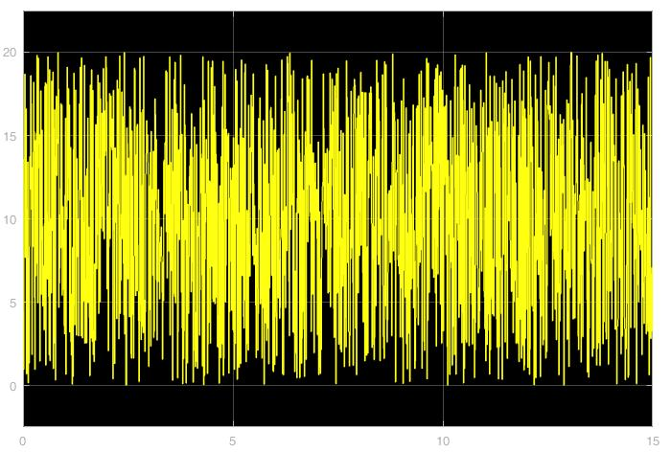

选取$η$=20 c1=10 c2=10 扰动F为幅值20的随机数
Reference signal: step input
仿真时间15s，sampling time 0.01s
Fig. disturbance

Slide 5
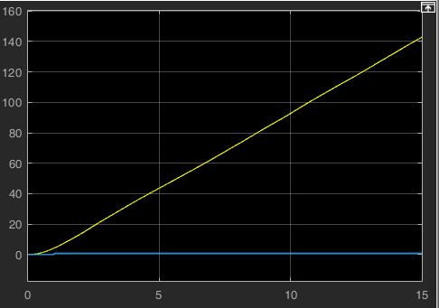
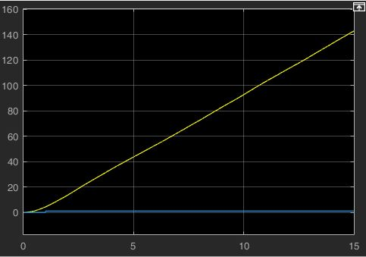
U-model control output (unstable)
output
reference
Joint 1
Joint 2

Slide 6
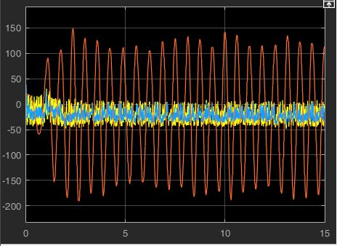
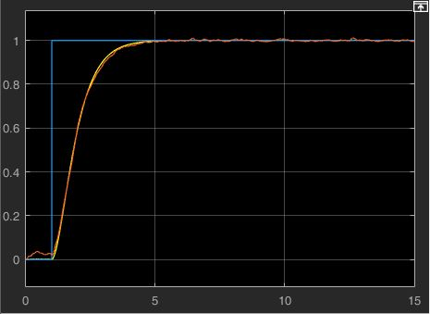
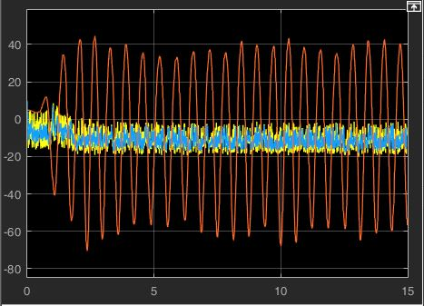
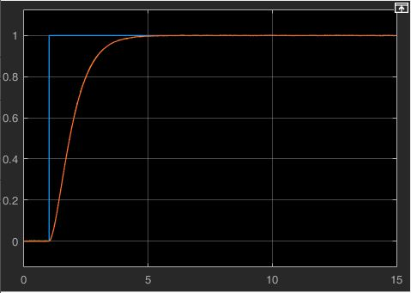
Control output (N*m)
angle output (rad)
SMC
USMC
Joint 1
U
Joint 2

Slide 7
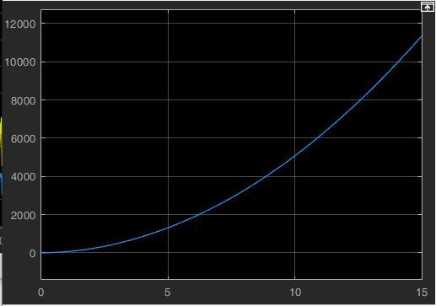
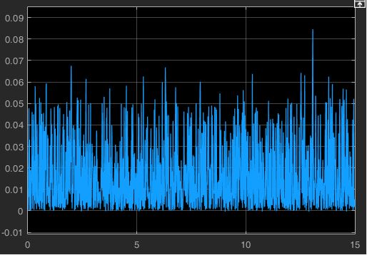
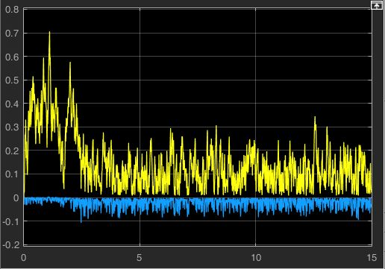
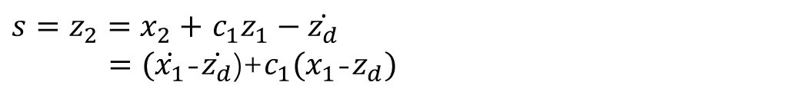
Sliding Variable
$s=z_{2}=$ $x_{2}+$ $c_{1}z_{1}−\dot{z_{d}}$
$=(\dot{x_{1}}$-$\dot{z_{d}}$)+${c_{1}(x}_{1}$-$z_{d})$
Joint 1
Joint 2
U
USMC
SMC

Slide 8
表现数据对比
控制输出量累加和
绝对误差累加和
 | control-U | control-SMC | control-USMC | error-U | error-SMC | error-USMC
q1 | 111260 | 296840 | 275390 | 814660 | 283.95 | 282.44
q2 | 368630 | 141500 | 136840 | 814660 | 283.95 | 284.54
out_port | 9, 10 | 1, 2 | 5, 6 | 11, 12 | 3, 4 | 7, 8
time: 15s | sample_time:0.01

Slide 9
初步观察
在有扰动的情况下，SMC和USMC的表现都比单独U-model好
SMC和USMC在角度误差和控制量方面差别不大
在滑模变量方面，SMC表现明显优于其他两种方法
疑问
USMC相比SMC的意义在哪里

